Slide 1
Community Assessment Rutherford County, Tennessee Geography, Population, & Environment
Group #3
Shelaina Lewis, Shannon Beaty, Wendy Hesson, Andria Russow, Hunter Peak, Kendra Sermsai, Miranda Farmer, Laura Keeter, Heather Harden, & Victoria Tipps

Slide 2
Geographical Information for Rutherford County
Total land area: 624 square miles
619 square miles of land
5 square miles of water
Ranked the 8th largest county in Tennessee
Murfreesboro is the geographic center of Tennessee and is the county seat

Slide 3
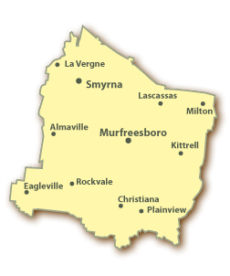
Geographical Information (cont.)
Cities and Towns:
Murfreesboro
Lavergne
Eagleville
Smyrna
Unincorporated
Communities:
Blackman
Lascassas
Rockvale
Walter Hill
National Protected Areas:
Stones River National Battlefield

Slide 4
Weather for Rutherford County
Annual Average Temp: 59.6 degrees
Monthly Average High Temp:
January: 45 degrees
July: 89 degrees
Monthly Average Low Temp:
January: 25 degrees
July: 67 degrees
Annual Average Precipitation: 51.95 in.
Annual Average Snowfall: 8.2 in
Prevailing Winds: South-Southwest
Mean Length of Freeze-Free Period: 180 days

Slide 5
Weather for Murfreesboro, Tennessee
 | Jan | Feb | Mar | Apr | May | Jun | Jul | Aug | Sep | Oct | Nov | Dec
Avg High | 45° | 50° | 60° | 70° | 78° | 86° | 88° | 88° | 82° | 72° | 60° | 50°
Avg Low | 24° | 27° | 36° | 45° | 54° | 62° | 66° | 65° | 58° | 44° | 37° | 28°
Daily Avg | 35° | 38° | 48° | 58° | 66° | 74° | 78° | 77° | 70° | 58° | 48° | 40°
Avg Prcpt (in) | 4.3 | 4.1 | 5.5 | 4.5 | 5.4 | 3.9 | 4.8 | 3.8 | 4.3 | 3.3 | 4.5 | 5.0

Slide 6
Population
Trends in Population
1990
Total population census: 118,570
Growth from 1990-2000: 53.52%
2000
Total population census: 182,023
Growth from 2000-2008: 32.6%
2008
Total population census: 241,355

Slide 7
2008 Demographic Information
Caucasian: 194,760
African Americans: 28,541
American Indian/Alaska Native: 727
Asian: 6,570
Native Hawaiian/ Pacific Islander: 109
Other: 10,648

Slide 8
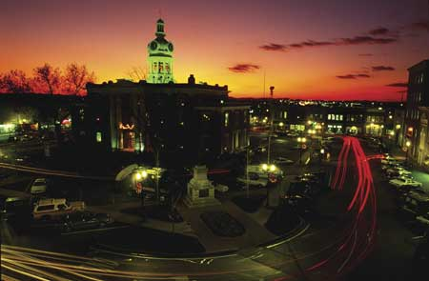
City Populations
Murfreesboro population
100,575
Smyrna population
38,073
Lavergne population
26,472
Eagleville population
491

Slide 9
Population
Male: 120,429 (49.9%)
Female: 120,926 (50.1%)
Under 18 years of age: 60,904 (25.2%)
18-24 years of age: 27,658 (11.5%)
25-34 years of age: 40,026 (16.6%)
35-54 years of age: 70,714 (29.3%)
55-64 years of age: 22,214 (9.2%)
65-84 years of age: 17,696 (7.34%)
Over 84 years of age: 2,143 (0.9%)
http://www.rutherfordchamber.org/economic-development/bic/demographics/population.php

Slide 10
Water Quality
Water Services provided for Rutherford County by:
The city of Lavergne Water and Sewer Department
The Town of Smyrna Water Treatment Plant
The City of Murfreesboro Water and Sewer Department
Consolidated Utility District (largest provider)
All of these providers use Stone River and Percy Priest Lake for supply
Water in Rutherford County is disinfected, filtered, and fluorinated

Slide 11
Sewage and Waste Disposal
The Solid Waste Department
Provides solid waste collection and transport services for the unincorporated areas of the county and limited services in incorporated areas.
Provides solid waste collection and transportation for all county and city schools.
Coordinates recycling services.
Operates 14 solid waste collection centers throughout the country.

Slide 12
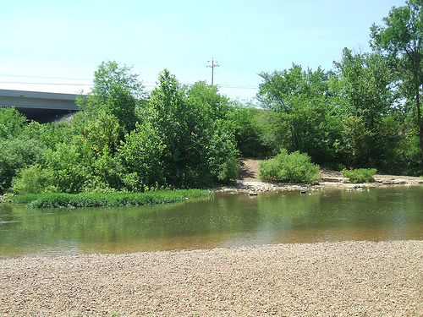
Sewage and Waste Disposal
Sewage goes to the wastewater treatment plant
Settable solids are removed by setting and sent to the landfill
The water is then filtered, disinfected by ultraviolent light, and aerated before discharge to the West Fork Stones River

Slide 13
Air Quality
Air Quality Index:
Percentage of days with good air quality: | 82
Percentage of days with moderate air quality: | 17
Percentage of days with unhealthful air quality for sensitive populations: | 0
Percentage of days with unhealthful air quality: | 0
Maximum AQI level in 2003 | 106
Median AQI level in 2003 | 38
90th Percentile AQI level in 2003 | 59

Slide 14
Air Quality
http://www.scorecard.org/env-releases/cap/state.tcl?fips_state_code=47#air_rankings
Air Quality Index
0 - 50 | Good
50 - 100 | Moderate
100 - 200 | Unhealthful
200 - 300 | Very Unhealthful
300 - 500 | Hazardous

Slide 15
Food Quality and Access
Rutherford County Health Department
Food and General Sanitation- environmental specialists inspect existing food service establishments and review plans for prospective one. Inspections are done on hotels, motels, public swimming pools, bed and breakfasts, childcare facilities, and school plants.
WIC(Women, Infants, and Children)
Children under the age of five, pregnant and breastfeeding who are at or below 185% of poverty and have a nutritional risk receive limited health screening, nutritional counseling, and food vouchers.

Slide 16
Housing Units (2000)
Total Housing Units
Rutherford County: 70,616
Renter Occupied Housing Units
Rutherford County: 20,035
Percent: 28.4
Tennessee percentage: 27.5
United States percentage: 30.8
Owner-Occupied Housing Units
Rutherford County: 46.408
Percent: 65.7
Tennessee Percentage: 64.0
United States Percentage: 60.2

Slide 17
Renter-Occupied Housing Units
 | Rutherford County | TN | US
Average # of household members | 2.31 | 2.24 | 2.36
Average # of rooms | 4.25 | 4.32 | 4.04
Average # of vehicles | 1.51 | 1.30 | 1.19
Median Year Structure was built | 1981 | 1974 | 1969
Median year householder moved in | 1999 | 1998 | 1998
Median Rent ($) | 520 | 408 | 519
Median rent asked for vacant units ($) | 586 | 391 | 469
Rent includes utilities (%) | 12.8 | 16.5 | 16.5
Rent as a % or household revenue | 27 | 25 | 26

Slide 18
Owner-Occupied Housing Units
 | Rutherford County | TN | US
Average # of household members | 2.80 | 2.58 | 2.71
Average # of rooms | 6.31 | 6.30 | 6.30
Average # of vehicles | 1.52 | 1.55 | 1.64
Median Year Structure was built | 1988 | 1976 | 1971
Median year householder moved in | 1995 | 1991 | 1991

Slide 19
Owner-Occupied Housing Units
 | Rutherford County | TN | US
Median value ($) | 111,600 | 88,300 | 111,800
With mortgage or contract to purchase | 69.1 | 51.0 | 55.4
With second mortgage or equity loan | 13.9 | 9.9 | 12.7
Median price asked for vacant housing ($) | 110,900 | 83,300 | 89,600
Monthly cost, with mortgage ($) | 978 | 882 | 1,088
Monthly cost, without mortgage ($) | 263 | 240 | 295

Slide 20
Housing in Rutherford County
Organizations in Tennessee that offer shelter and emergency housing to the homeless:
The Salvation Army
1137 W. Main St., Murfreesboro, TN
615-895-7071

Slide 21
Housing in Rutherford County
Low-income housing
Murfreesboro Housing Authority
Number of Conventional Public Housing: 350
Number of Section & Vouchers: 576
Number of Units in Westbrooks Towers Elderly High-rise: 230 one Bedroom suites
Number of Shelter Plus Care Vouchers for Homeless/Disabled: 20
Websites:
http://www.mha-tn.org/
http://www.smyrnahousingauthority.com/
http://www.tennlegalaid.com/Library/Documents/1150909438.8/Section8Rutherford.pdf

Slide 22
Animal Control
According to the Rutherford County Animal Control Website
If any dog or cat has bitten any person or is suspected of having rabies, the Animal Services Department may cause such dog or cat to be confined or isolated at the owner’s home, at a veterinary hospital, or at the Animal Services facility for such time as the health department deems it necessary to protect the safety of the people and community.
The owner of such dog or cat is liable for board fees in the amount of $15.00 per day if such dog or cat is confined to Animal Shelter

Slide 23
Animal Control (cont.)
Any person who owns, keeps, or harbors a dog or cat within the county shall have the dog or cat properly inoculated or immunized against rabies
Law in the state of Tennessee that all pets should have rabies vaccinations
Several sources report that Rutherford County has the highest reported cases of rabies in Tennessee.
Rutherford County does have a leash law

Slide 24
According to the CDC…
131 cases of rabies in the state of Tennessee in animals (domestic and wildlife)
http://www.cdc.gov/rabies/docs/rabies_surveillance_us_2006.pdf
So far in 2008, no West Nile Virus detected in humans or mosquitoes
http://diseasemaps.usgs.gov/wnv_tn_mosquitoe.html
The city of Murfreesboro does not spray its community for mosquitoes
http://www.nospraynashville.org/othercities.html

Slide 25
Health Outcomes
 | Tennessee | Rutherford County | Rank
Mortality (years of potential life lost/100,000) | 9092.7 | 6873.8 | 4
Low birth weight (%) | 9.4 | 8.8 | 43
General health status % fair/poor health) | 19.5 | 22.7 | 41

Slide 26
Health Determinants
Health Care
 | Tennessee | Rutherford County | Rank
No health insurance (%) | 14.0 | 16.6 | 73
Doctors per capita (per 100,000) | 227.0 | 148.1 | 20
Dentists per capita (per 100,000) | 48.9 | 43.7 | 19
Percent without pneumococcal vaccinations | 77.6 | 78.7 | 68
Percent without influenza vaccinations | 71.8 | 78.5 | 70
No biennial mammography (%) | 17.4 | 14.9 | 3

Slide 27
Health Determinants
Health Care Continued
 | Tennessee | Rutherford County | Rank
No diabetic eye exams (%) | 63.6 | 66.5 | 70
No diabetic lipid profile (%) | 85.2 | 87.0 | 55
No diabetic HbA1c testing (%) | 85.6 | 85.3 | 44

Slide 28
Health Behaviors
 | Tennessee | Rutherford County | Rank
Cigarette Smoking (%) | 26.7 | 24.5 | 23
Smoking during Pregnancy (%) | 19.2 | 16.8 | 9
Physical Inactivity (%) | 33.1 | 35.2 | 31
Overweight Obesity (% BMI>30) | 62.3 | 66.4 | 73
Low fruit and vegetable consumption (%<5 fruit/veg a day) | 26.5 | 23.3 | 35

Slide 29
Health Behaviors
 | Tennessee | Rutherford County | Rank
Binge drinking (%) | 8.6 | 4.5 | 1
Teen birth rate (per 1,000) | 50.5 | 40.8 | 21
Sexually Transmitted diseases (per 100,000) | 295.7 | 330.6 | 69
Violent crime (per 100,000) | 10660.9 | 1901.7 | 18
Motor vehicle crash deaths (per 100,000) | 22.8 | 17.6 | 20

Slide 30
Socioeconomic Factors
 | Tennessee | Rutherford County | Rank
High School Graduation rate (%) | 81.8 | 87.8 | 21
Level of Education (%) | 74.9 | 84.9 | 4
Unemployment (%) | 5.6 | 3.9 | 3
Children (age 0-17) in poverty ratio (%) | 19.2 | 11.5 | 3
Divorce rate (per 100,000) | 5.4 | 5.7 | 65

Slide 31
Physical Environment
 | Tennessee | Rutherford County | Rank
Air Quality cancer risk (per 1,000,000) | 0.0 | 0.0 | 81
Air Quality hazard index (per 1,000,000) | 3.3 | 2.9 | 83
Air Quality-fine particulate matter in air (Mg/m3) | 13.5 | 13.2 | 23
Ozone Level (ppd) | 0.1 | 0.1 | 72
Nitrate levels in water >2 (%) | 3.3 | 2.7 | 52
Pre-1950 housing (%) | 14.5 | 6.3 | 2
Lead poisoned children (%) | 0.5 | 0.0 | 1

Slide 32
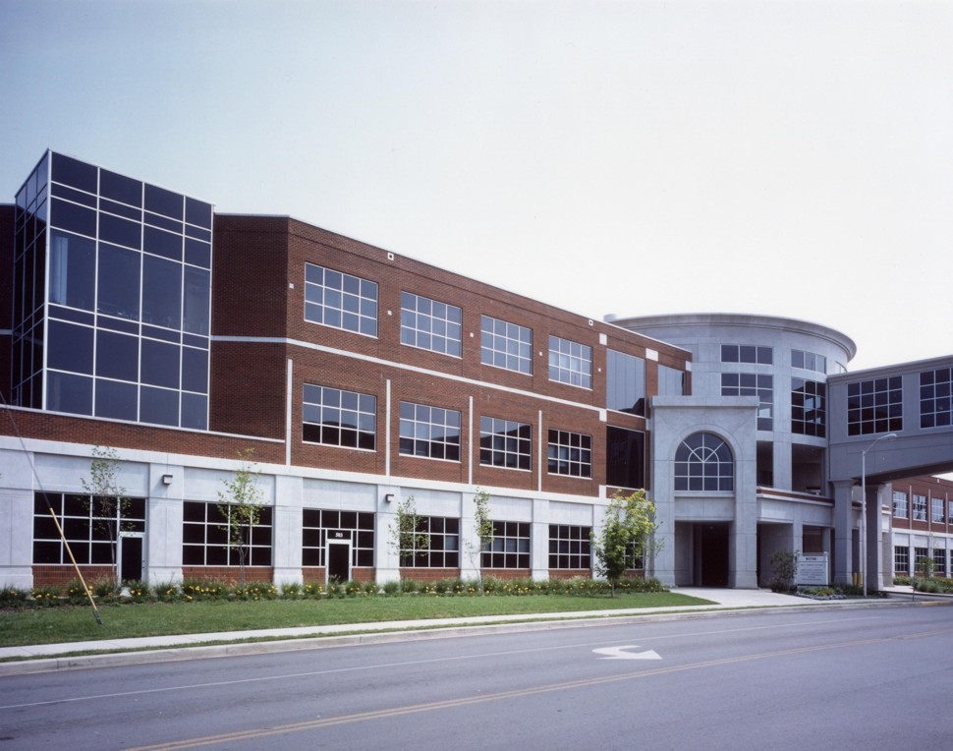
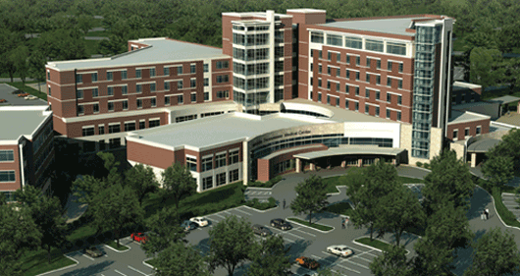
Overall Rank
Rutherford County is currently ranked as the 3rd healthiest out of the 95 counties.

Slide 33
Mortality Rank
The mortality index measures levels or premature death indicated by years of potential life lost per 100,000 individuals.
At 6,874, Rutherford County ranks 4th in the state and better than the national average.

Slide 34
Strengths of Rutherford County
Biennial mammography
Smoking during pregnancy
Binge drinking
Level of education
Children in poverty
Pre-1950 housing
Lead poisoned children

Slide 35
Challenges in Rutherford County
Health insurance coverage
Influenza vaccinations
Diabetic eye examinations
Overweight/obesity
Air quality indicators
Ozone level

Slide 36
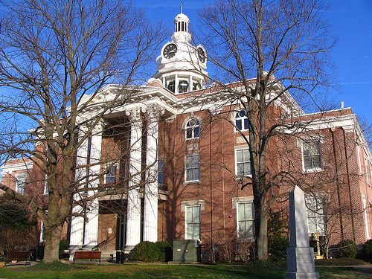
Crime Rates in Rutherford County (2005)
Offense Overview
Offense Total: 3,994
Number Cleared: 1,066
Percent Cleared: 26.7%
Arrest Overview
Total Arrests: 5,636
Adult Arrests: 5,025
Juvenile Arrests: 611
Arrests per 100,000 population: 2,683.5
Average number of offenses/incidents: 1.10

Slide 37
Crime Rates in Murfreesboro (2005)
Offense Overview
Offense Total: 10,210
Number Cleared: 1,945
Percent Cleared: 19.0%
Arrest Overview
Total Arrests: 4,393
Adult Arrests: 3,814
Juvenile Arrests: 575
Arrests per 100,000 population: 5389.5
Average Number Offenses/Incident: 1.17

Slide 38
Average Household Income
Rutherford County: $69,038
Murfreesboro: $68,044

Slide 39
Unemployment
2006
Rutherford County
3.9%
Tennessee
5.1%
United States
4.6%
2005
Rutherford County
4.1%
Tennessee
5.6%
United States
5.0%

Slide 40
Food Banks
Smyrna-Lavergne Food Bank
130 Richardson Road, Smyrna
615-355-0697
Rutherford County Food Bank
211 Bridge Avenue, Murfreesboro
615-895-1148

Slide 41
Food Banks
Clients receive canned foods, milk, cheese, butter, and eggs based on the size and income of the family.
Larger families receive more canned goods.
Food can be picked up once a month.
Applicants must bring Social Security cards for every member of the family, proof of income, and proof they live in Rutherford County area.
Also should bring proof of utility, rent, telephone, and gasoline expenses.

Slide 42
Food Stamps
DHS for Rutherford County is where to apply for food stamps.
Dist. 5, City #75
1711B Old Fort Pkwy
Murfreesboro, TN 37129
615-848-5153
Services: Food Stamps, Families First, Medicaid, and TennCare
Food Stamps eligibility website:
http://www.tn.gov/humanserv/adfam/fs_1.htm

Slide 43
Meals on Wheels
Mid-Cumberland HRA Meals on Wheels
203 Front St., Smyrna
615-459-2227
Murfreesboro Nutrition Site
325 St. Clair St., Murfreesboro
615-895-1870

Slide 44
Meals on Wheels
Provides hot, nutritional meals to the elderly of Rutherford County as a means of assisting persons age 60 years and older in maintaining their dignity, health, and independence.
180 meals are either delivered weekly or served at the St. Clair Senior Center in Murfreesboro.

Slide 45
Nursing Diagnosis for the Community

Slide 46
References
http://www.go-tennessee.com/Murfreesboro/ Weather/
http://www.rutherfordchamber.org/economic-development/bic/quality-of-life/cllimate.php
http://www.epodunk.com/cgi-bin/housOverview.php?locIndex=12648
http://www.rutherfordcounty.org/pets/
http://www.smyrnahousingauthority.com/
http://www/tennlegalaid.com/Library/Documents/1150909438.8/Section8Rutherford.pdf
http://www.cdc.gov/rabies/docs/rabies_surveillance_us_2006.pdf
http://diseasemaps.usgs.gov/wnv_tn_mosquitoe.html
http://www.nospraynashville.org/othercities.html

Slide 47
References
www.rutherfordcountytn.gov
www.murfreesborotn.gov
www.scorecard.org
http://www.rutherfordchamber.org/economic-development/bic/demographics/population.php
http://images.google.com/imghp?ie=UTF-8&hl=en&tab=wi
Tennessee Institute of Public Health

